Slide 1
Data Engineering in MLOps
The Hoang
Understand and Implement Production-Grade Machine Learning Operations

Slide 2
Learning Objectives
Introduction of Data Engineering
Data Engineering: Core Components
Data Engineering in Machine Learning, MLOps
Hands-On Practice

Slide 3
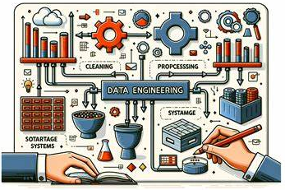
What is Data Engineering?
Definition
Data Engineering is the practice of designing, building, and maintaining data pipelines that prepare data for analysis and machine learning models.
It involves data ingestion, transformation, storage, and retrieval.

Slide 4
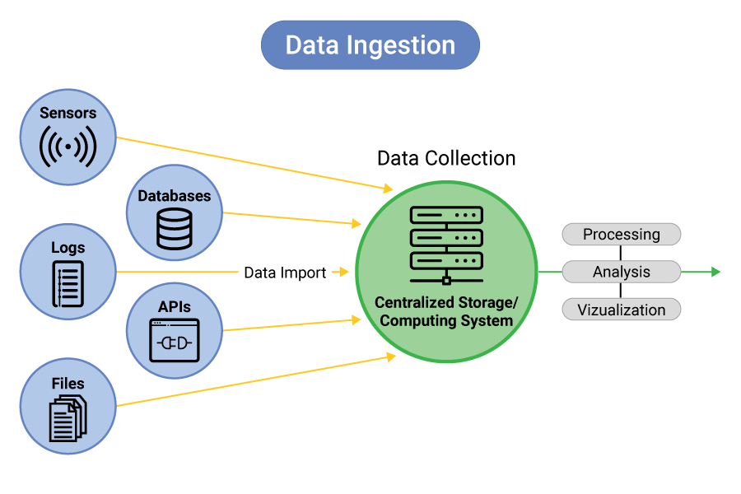
Core Components – Data Ingestion
This is the process of collecting data from various sources.
Batch Ingestion → Data collected at intervals (e.g., daily logs, files).
Streaming Ingestion → Real-time data processing (e.g., Kafka, Kinesis).
ETL (Extract, Transform, Load) vs. ELT (Extract, Load, Transform).
Common Tools:
Batch: Apache Nifi, Airflow, dbt, Talend
Streaming: Apache Kafka, Apache Flink, AWS Kinesis
Cloud Storage: AWS S3, Google Cloud Storage, Azure Blob

Slide 5
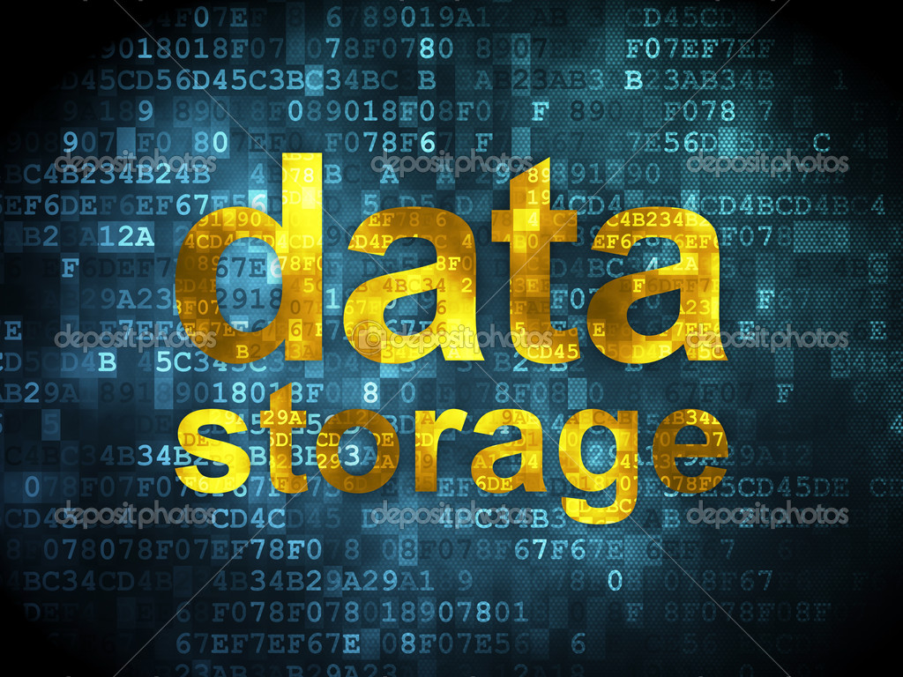
Core Components – Data Storage
Once data is ingested, it needs to be stored efficiently.
Databases (OLTP) → For transactional data (e.g., MySQL, PostgreSQL).
Data Warehouses (OLAP) → For analytics (e.g., Snowflake, BigQuery, Redshift).
Data Lakes → For raw & semi-structured data (e.g., AWS S3, Delta Lake).
Lakehouse → Hybrid of Data Lakes & Warehouses (e.g., Databricks, Iceberg).
Storage Formats:
Structured → SQL databases, Parquet, ORC
Semi-structured → JSON, Avro, XML
Unstructured → Logs, images, videos
Feature Stores (e.g., Feast, Tecton) store ML features for reuse.

Slide 6
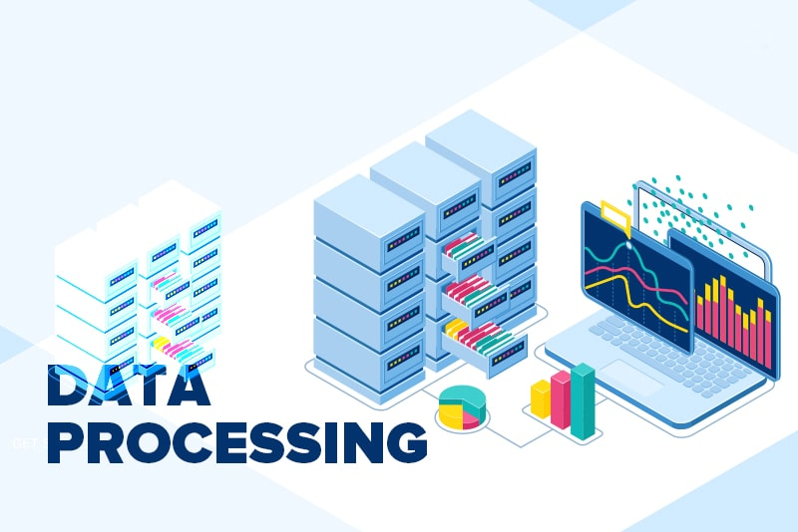
Core Components – Data Processing
Once stored, data often needs cleaning & transformation.
Batch Processing → Large data at scheduled times (e.g., Apache Spark, Pandas).
Stream Processing → Real-time processing (e.g., Apache Flink, Kafka Streams).
ETL vs. ELT for ML:
ETL: Preprocess data before storing it.
ELT: Store raw data and transform it later using SQL or Spark.
ML Pipelines often use ELT because raw data can be reused for different tasks.

Slide 7
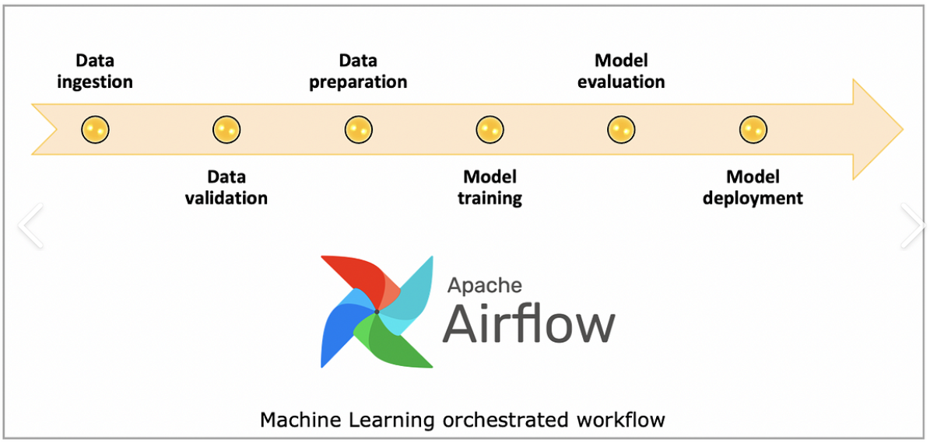
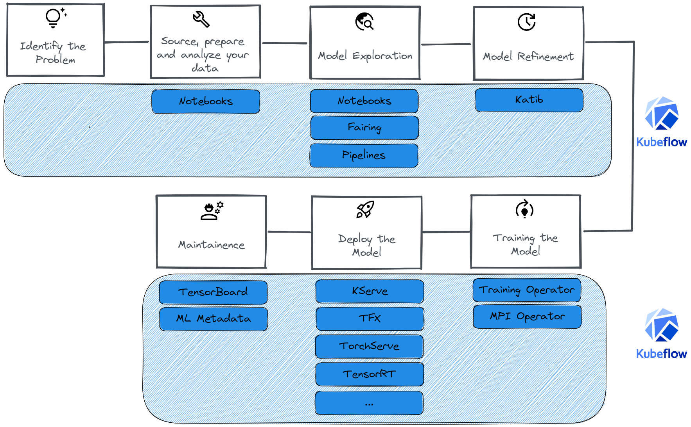
Workflow Orchestration
Data Engineering workflows need to be automated.
Apache Airflow: Popular for scheduling pipelines.
Prefect, Dagster: Modern alternatives.
KubeFlow Pipelines: Designed for ML workflows.
For ML & MLOps:
Automate data preparation for model training.
Run feature engineering jobs periodically.
Integrate with ML pipelines (e.g., Airflow + Kubeflow).

Slide 8
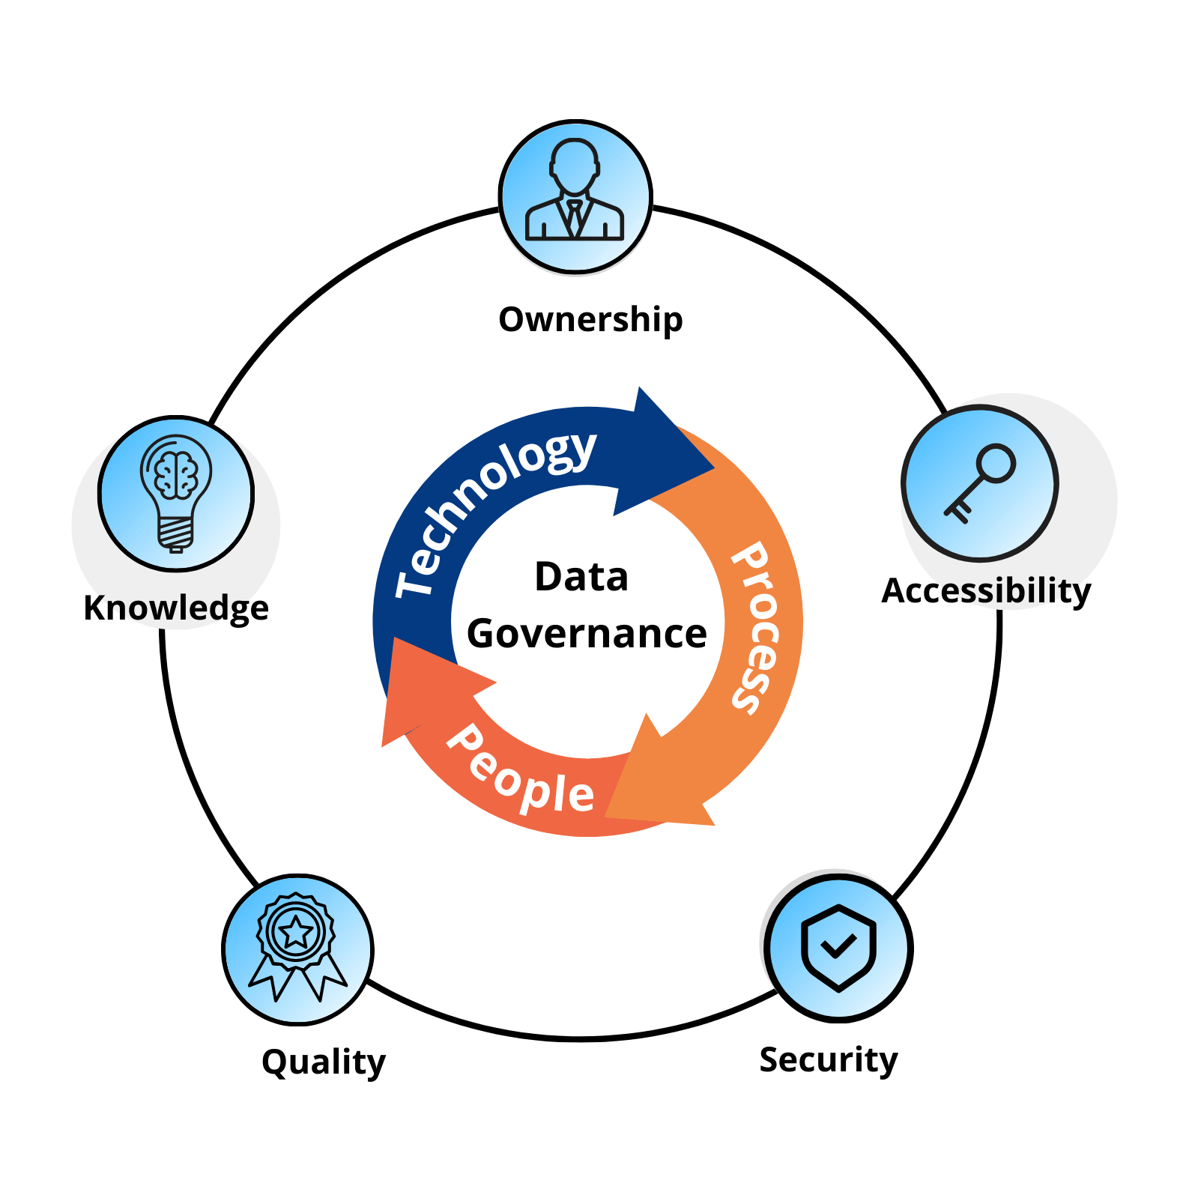
Data Quality & Governance
ML models rely on high-quality data.
Data Validation → Great Expectations, Deequ
Data Lineage → Apache Atlas, DataHub
Schema Management → Apache Avro, Protobuf
Feature Store Governance → Feast
Key for ML:
Detect data drift and anomalies.
Ensure consistent feature engineering.

Slide 9
Building a Data Pipeline for ML – 1/2
Step 1: Data Collection
Collect structured & unstructured data.
Use Kafka/Kinesis for real-time ingestion.
Step 2: Data Storage
Store raw data in S3, Delta Lake, or BigQuery.
Use Feature Stores for ML features.
Step 3: Data Processing
Use Apache Spark, dbt, or Pandas for transformation.
Stream processing with Apache Flink/Kafka Streams.

Slide 10
Building a Data Pipeline for ML – 2/2
Step 4: Data Validation
Use Great Expectations or Deequ to test data quality.
Step 5: Workflow Automation
Use Apache Airflow or Prefect to schedule jobs.
Step 6: Model Training & Deployment
Use Kubeflow, MLflow, or TFX for ML lifecycle.
Monitor data drift to trigger retraining.

Slide 11
Key Data Engineering Skills for MLOps
Category | Tools & Frameworks
Programming | Python, SQL, Scala
Data Storage | PostgreSQL, Snowflake, BigQuery, Delta Lake
Data Processing | Apache Spark, Pandas, dbt, Flink
Data Orchestration | Apache Airflow, Prefect, Dagster
Streaming | Apache Kafka, AWS Kinesis
Feature Store | Feast, Tecton, Hopsworks
Data Validation | Great Expectations, Deequ
MLOps | MLflow, Kubeflow, TFX

Slide 12
Recommended Learning Resources
Books
Designing Data-Intensive Applications – Martin Kleppmann
Fundamentals of Data Engineering – Joe Reis & Matt Housley
Data Pipelines with Apache Airflow – Bas Harenslak
Courses
Google Cloud Data Engineer Certification (Coursera)
Data Engineering Zoomcamp (Free, by DataTalksClub)
Spark & Airflow for Data Engineering (Udemy)
Hands-On Learning
Build a real-time analytics pipeline using Kafka & Flink.
Create a feature store and integrate it into an ML model.
Automate data pipelines with Airflow & MLOps tools.

Slide 13
Hands-On Practice
Data Ingestion & Storage
Data Processing & Transformation
Data Orchestration with Apacheflow

